Slide 1
World
Religions
Sacred
Spaces
What Is Religion
What is Religion?
Everyone is different. We look different. We act different. And we enjoy different things.
Can you think of one way you are like the person sitting next to you and one way you are different?
People also have different ideas about the meaning of life. These ways of thinking are sometimes called religions. All religions have stories that have been passed down for hundreds of years and rituals that everyone does together. Most religions also talk about God, gods and goddesses, or other deities.
Have you ever heard of any religions before? Does your family, or someone else you know, practice a religion?

Slide 2
World
Religions
Sacred
Spaces
What Is Religion
Sacred Spaces
People who practice a religion usually like to get together with others who practice the same religion. They might come together to pray, light candles, sing, meditate, dance, make offerings, or participate in ceremonies.
Have you ever gathered with other people to do any of those things?
The places where people meet for those types of activities are sometimes called sacred spaces. They are places that help people connect with something deeper, or bigger, than themselves.
Have you ever been in a sacred
space before?
Today we’re going to learn about different types of sacred spaces for different religions.

Slide 3
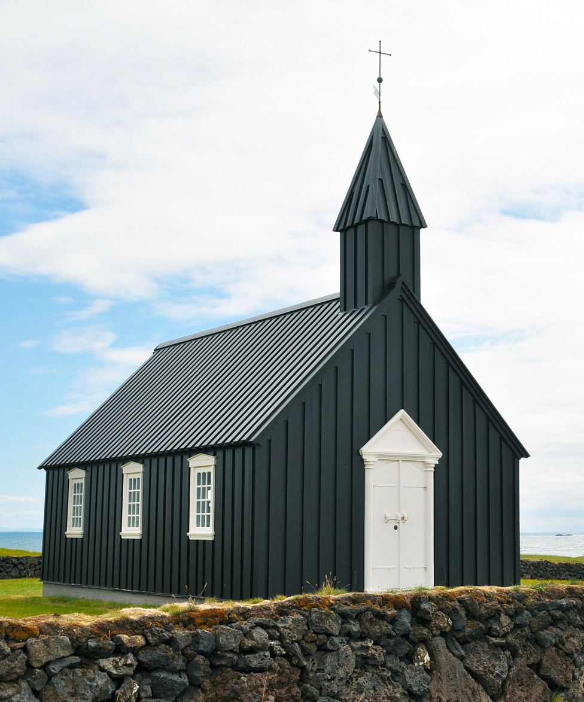
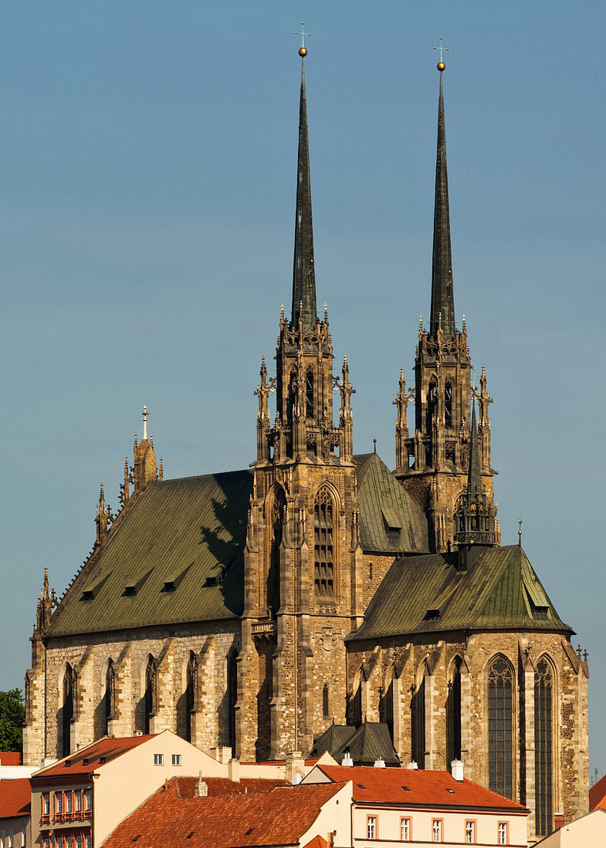
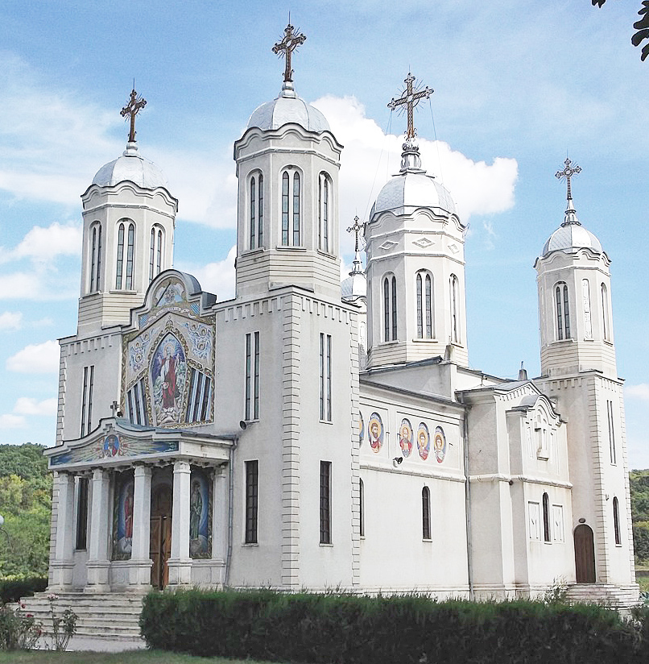
World
Religions
Sacred
Spaces
What Is Religion
Christianity
Christianity is the most common religion in the United States, and their sacred spaces are usually called churches.
What Is Religion
Do these churches look similar in any ways?

Slide 4
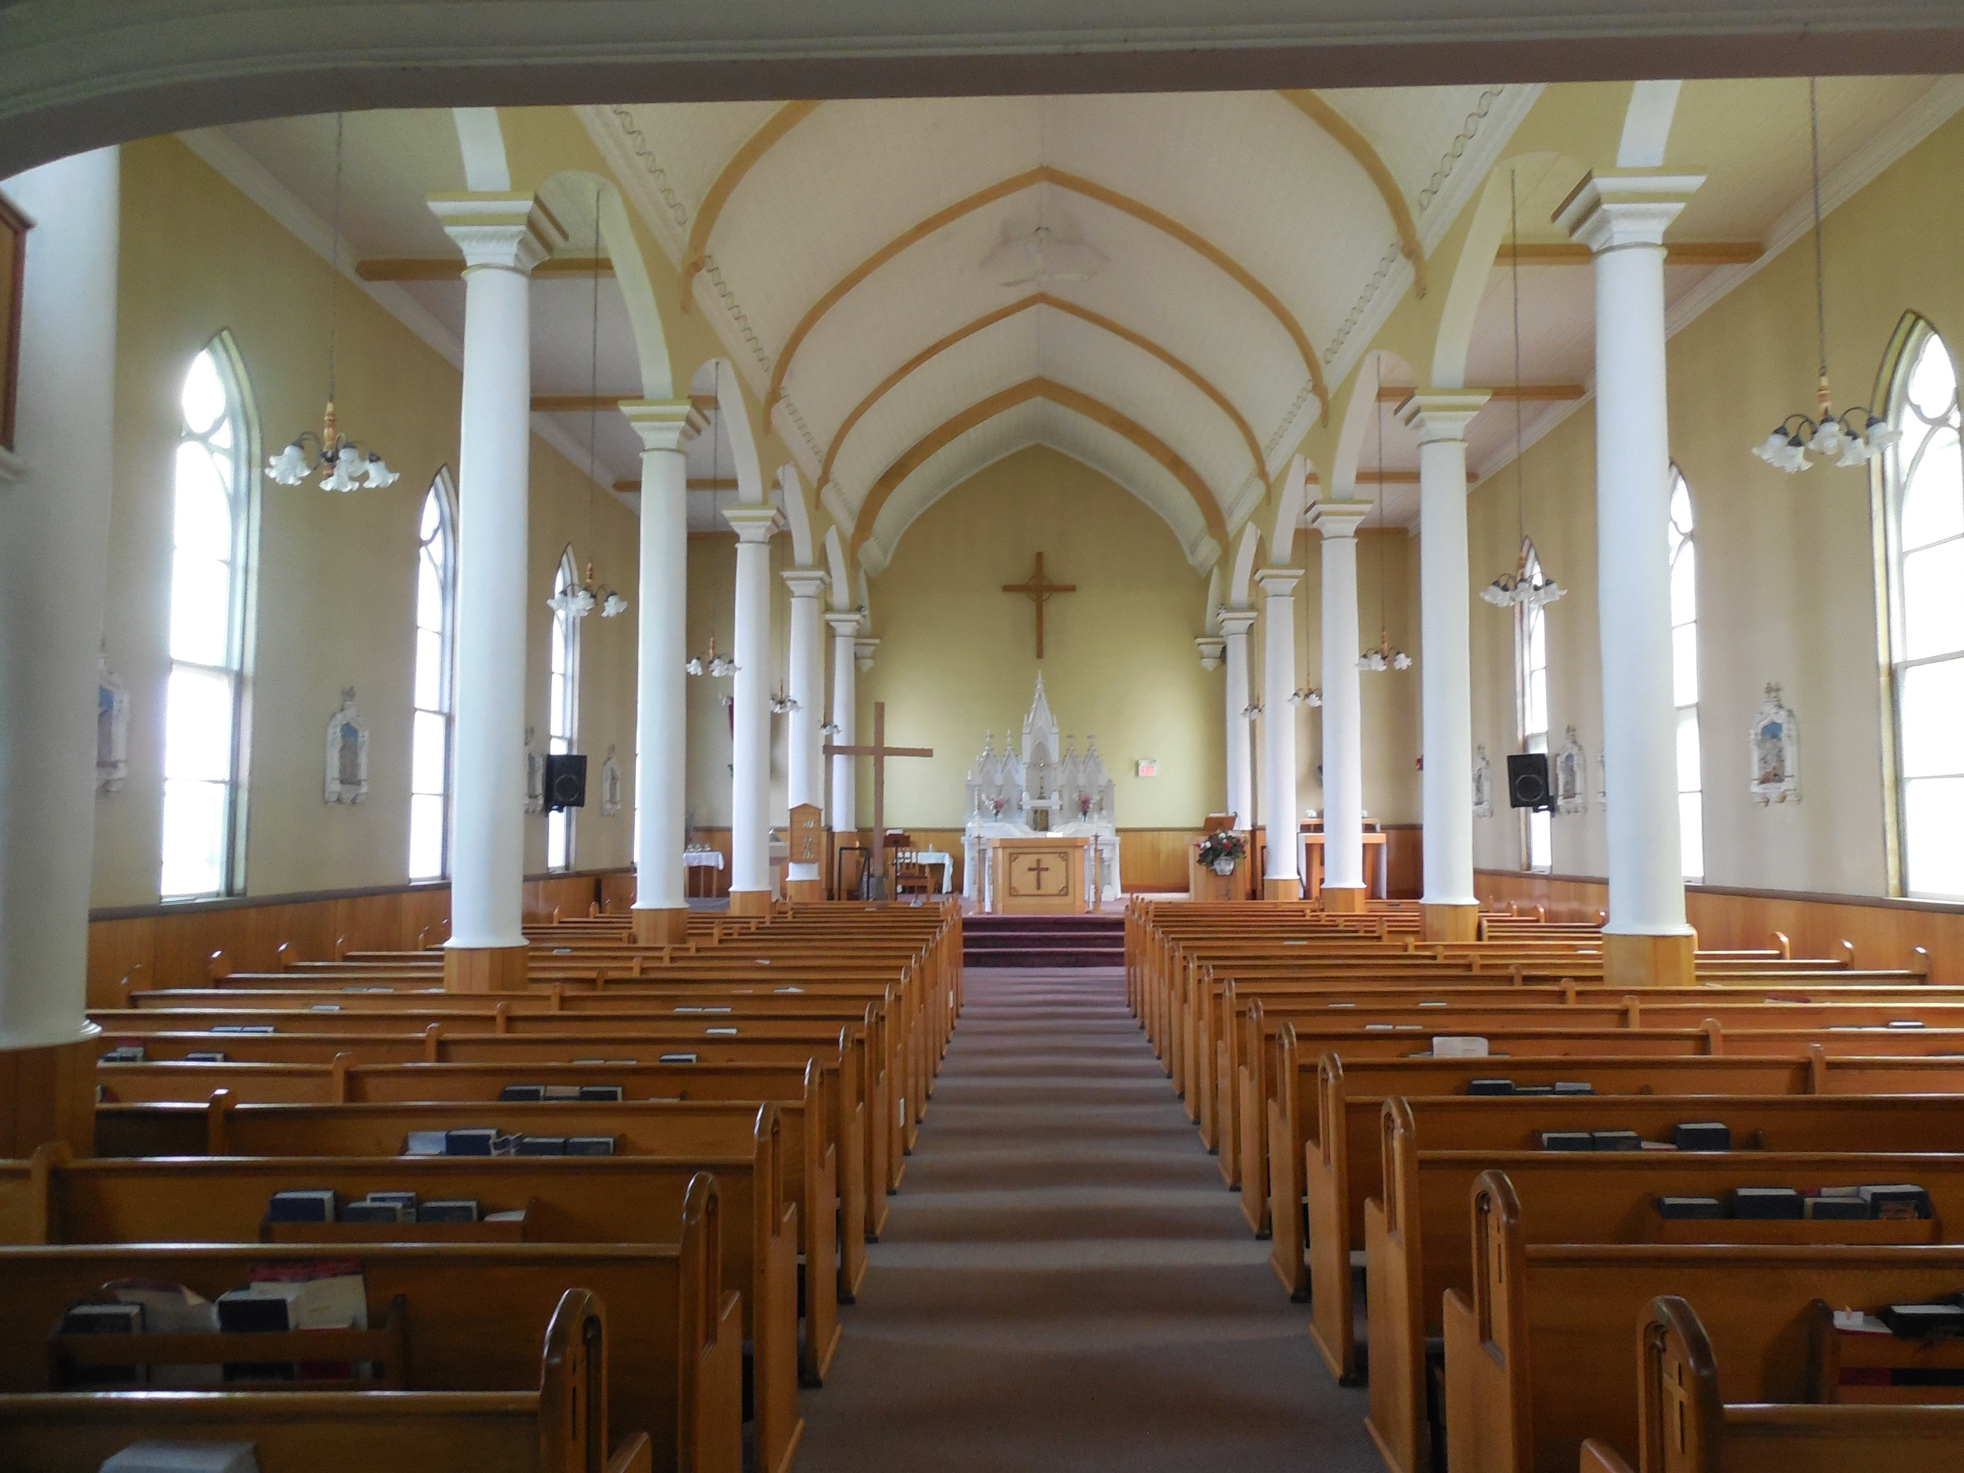
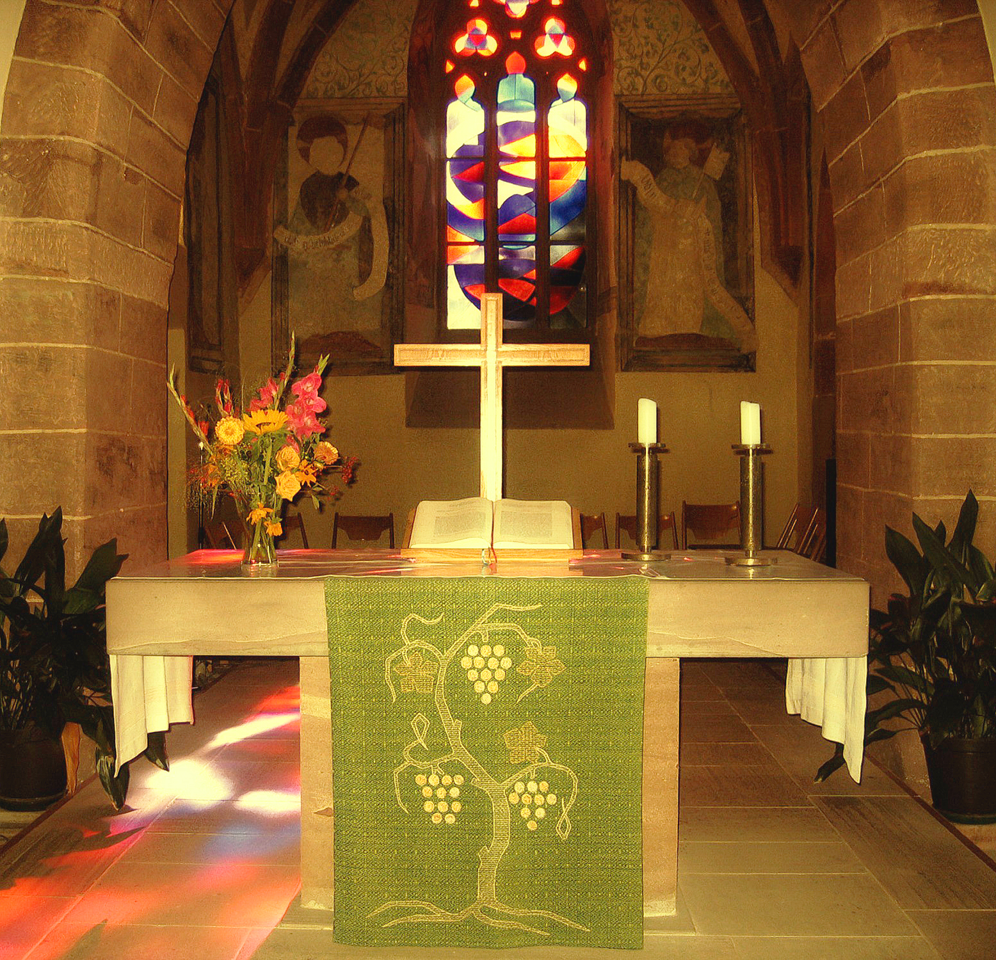
World
Religions
Sacred
Spaces
What Is Religion
Christian Churches
Nice job! Most churches have at least one cross because that is a symbol of Christianity. Many churches also have domes or steeples on top.
What Is Religion
If you go inside a church, you might see pews, which are long benches where people sit. At the front, you’ll also see an altar, which is a special table. In churches, altars often hold a cross and a Bible. Sometimes, they also have candles and flowers.
What Is Religion
Have you ever been inside a church? Did you see any of these things?

Slide 5
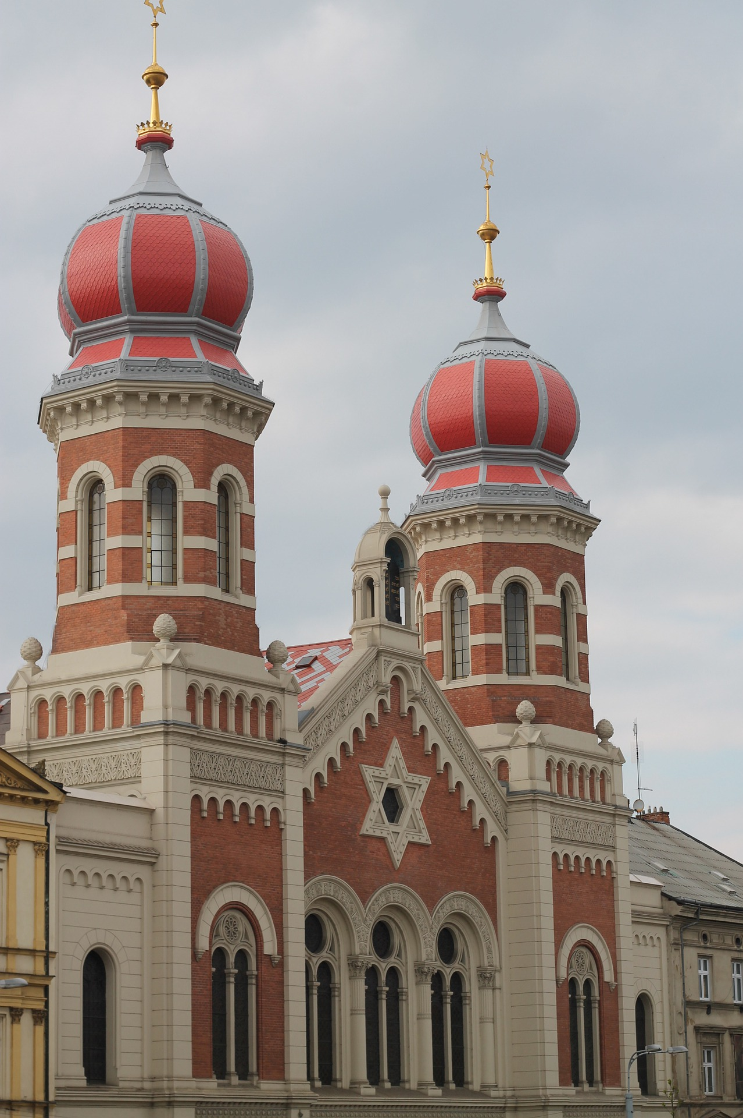
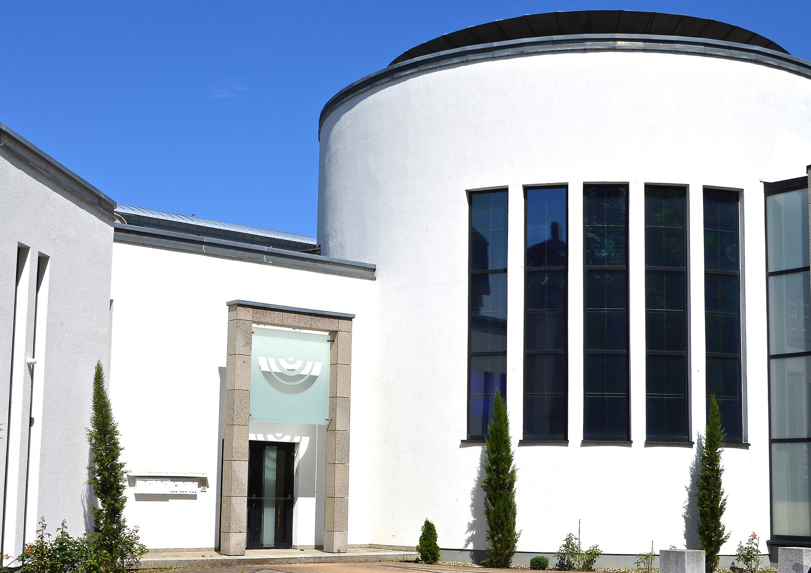
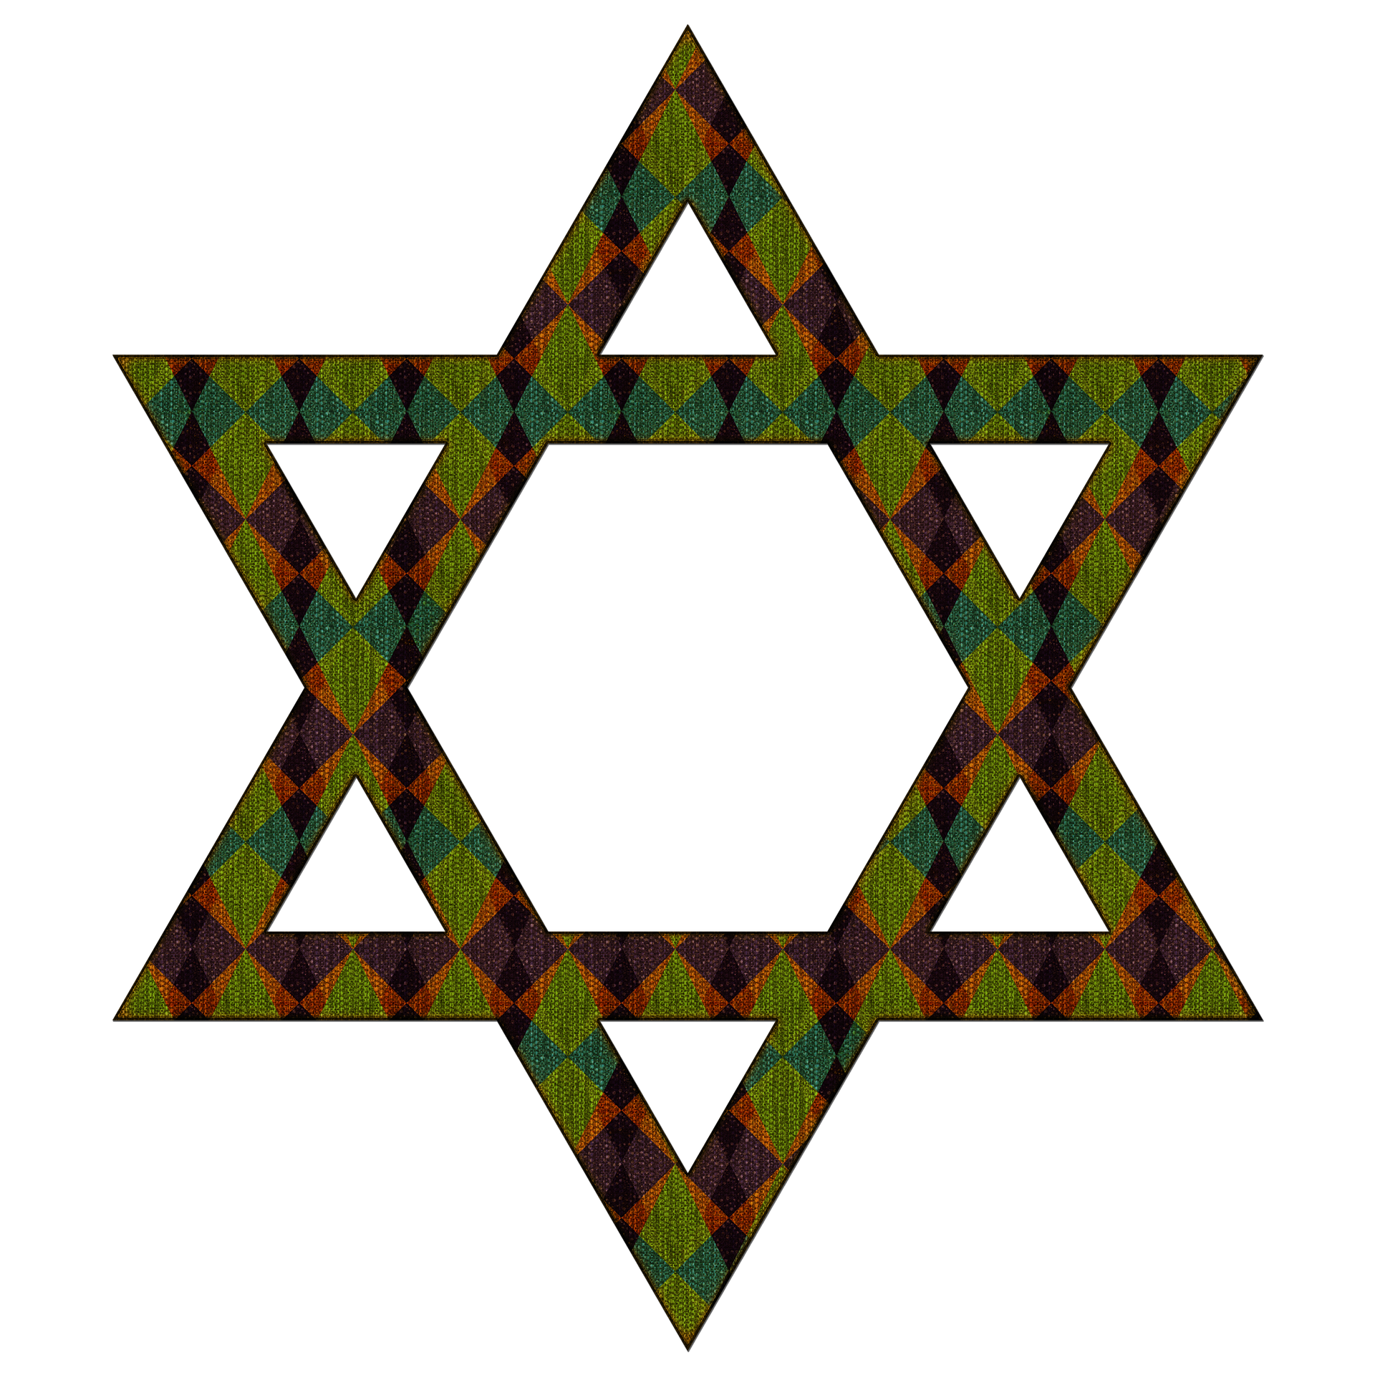
World
Religions
Sacred
Spaces
What Is Religion
Judaism
Another religion found in the United States is Judaism. Their sacred spaces are often called synagogues. They come in all shapes and sizes, but they often have a Star of David - an important symbol in Judaism.
What Is Religion
Can you find the Star of David on the red synagogue?

Slide 6
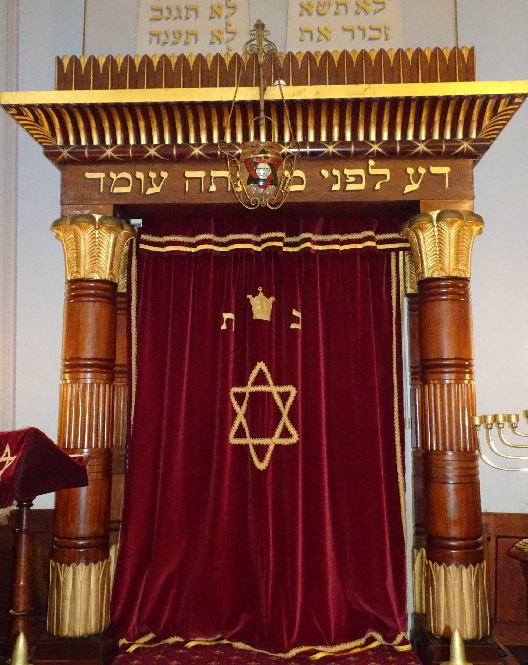
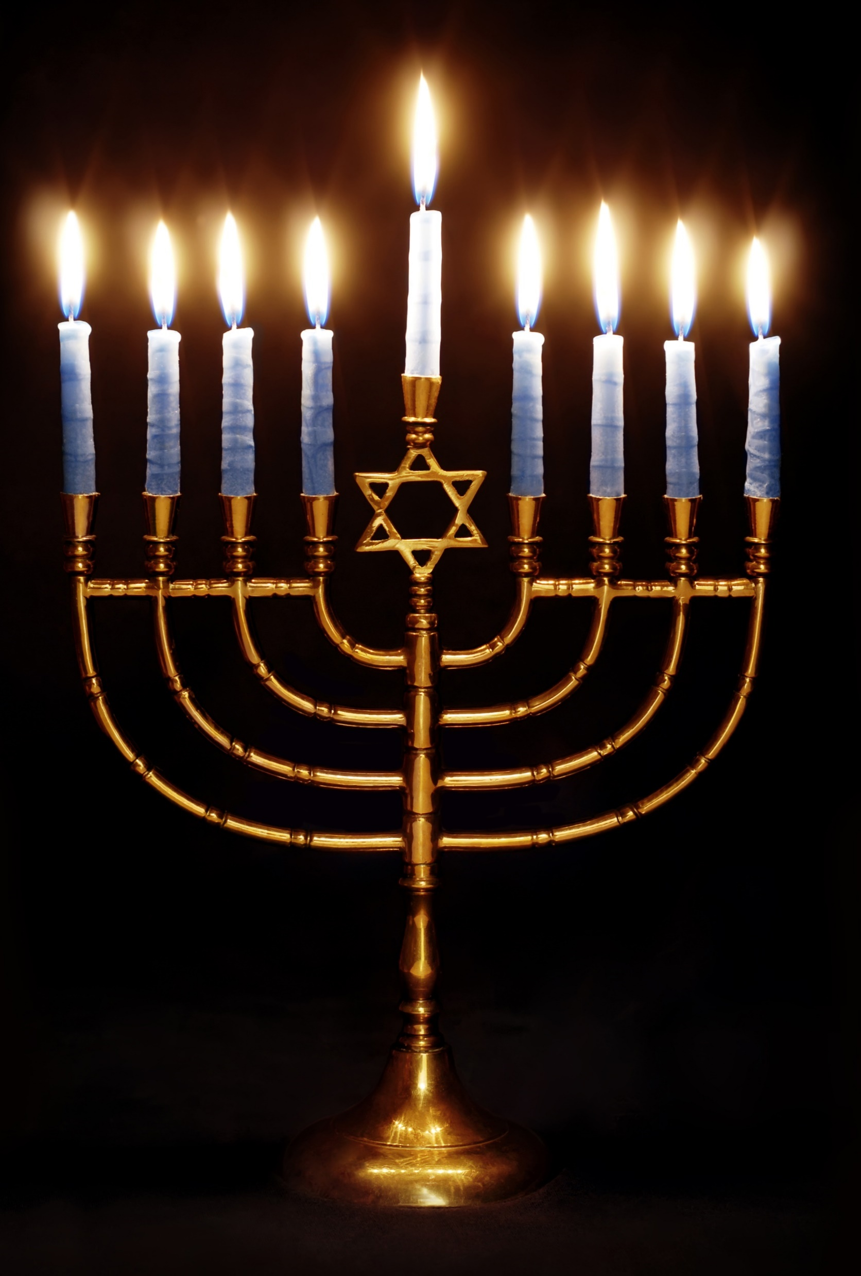
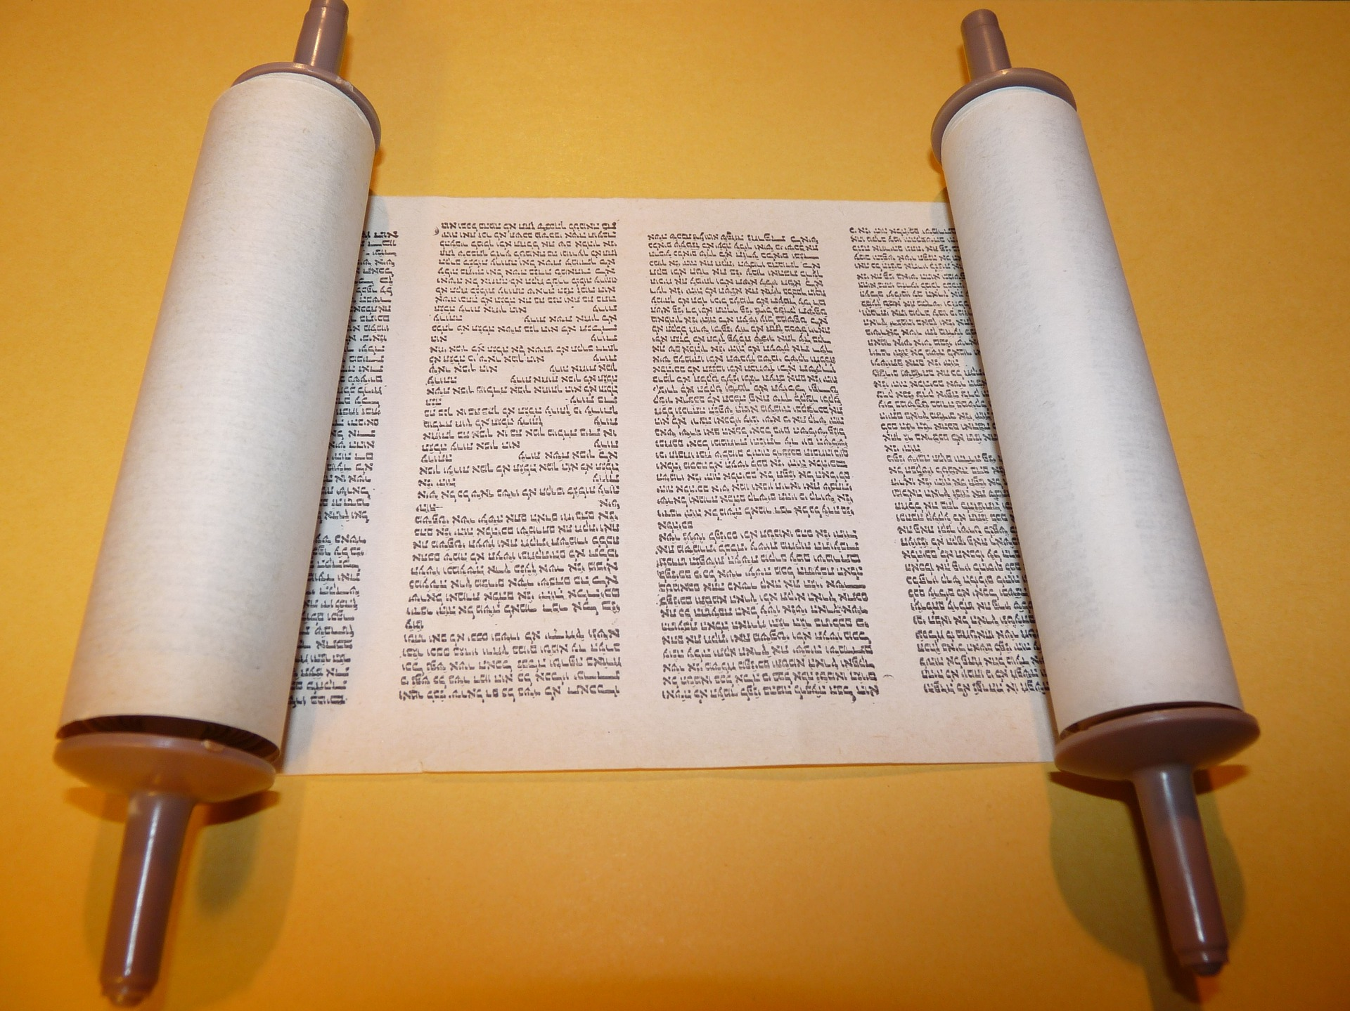
World
Religions
Sacred
Spaces
What Is Religion
Jewish Synagogues
Once inside, you’ll see a cabinet with doors or a cloth curtain. It holds scrolls that contain hand-written versions of special books from the Jewish Bible. Scrolls are written in a language called Hebrew.
What Is Religion
You’ll also see a special candle-holder, called a menorah.
What Is Religion
Have you ever lit candles for a holiday or special occasion?

Slide 7
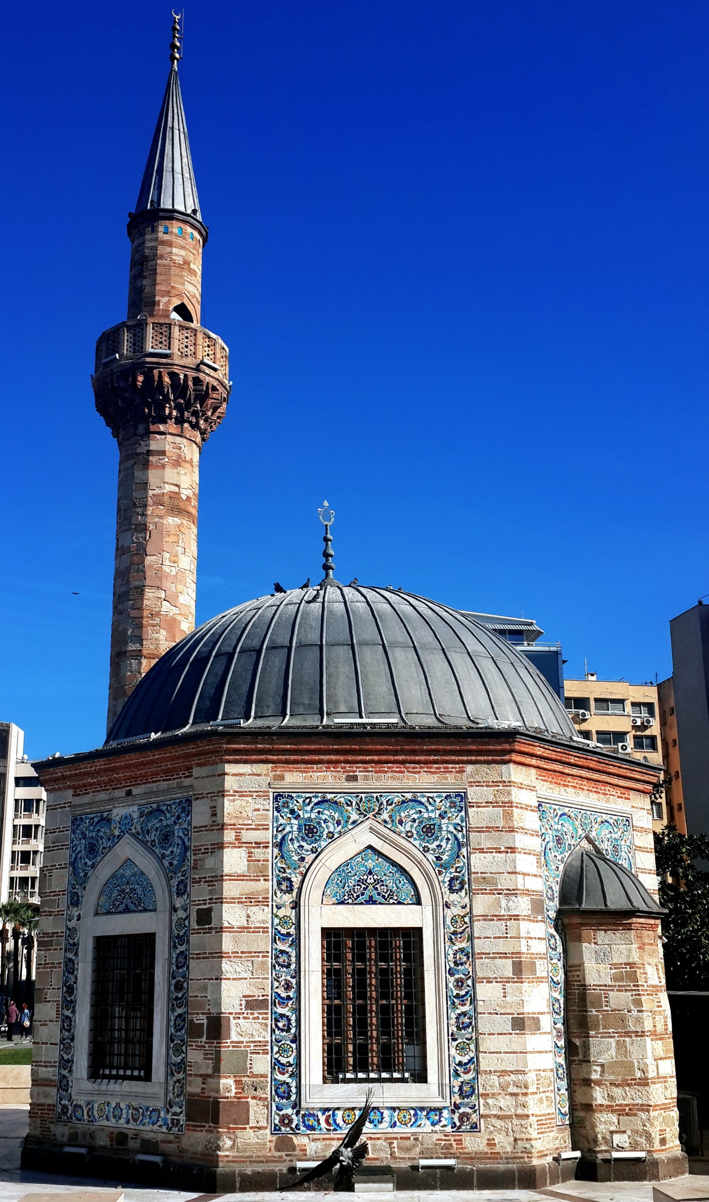
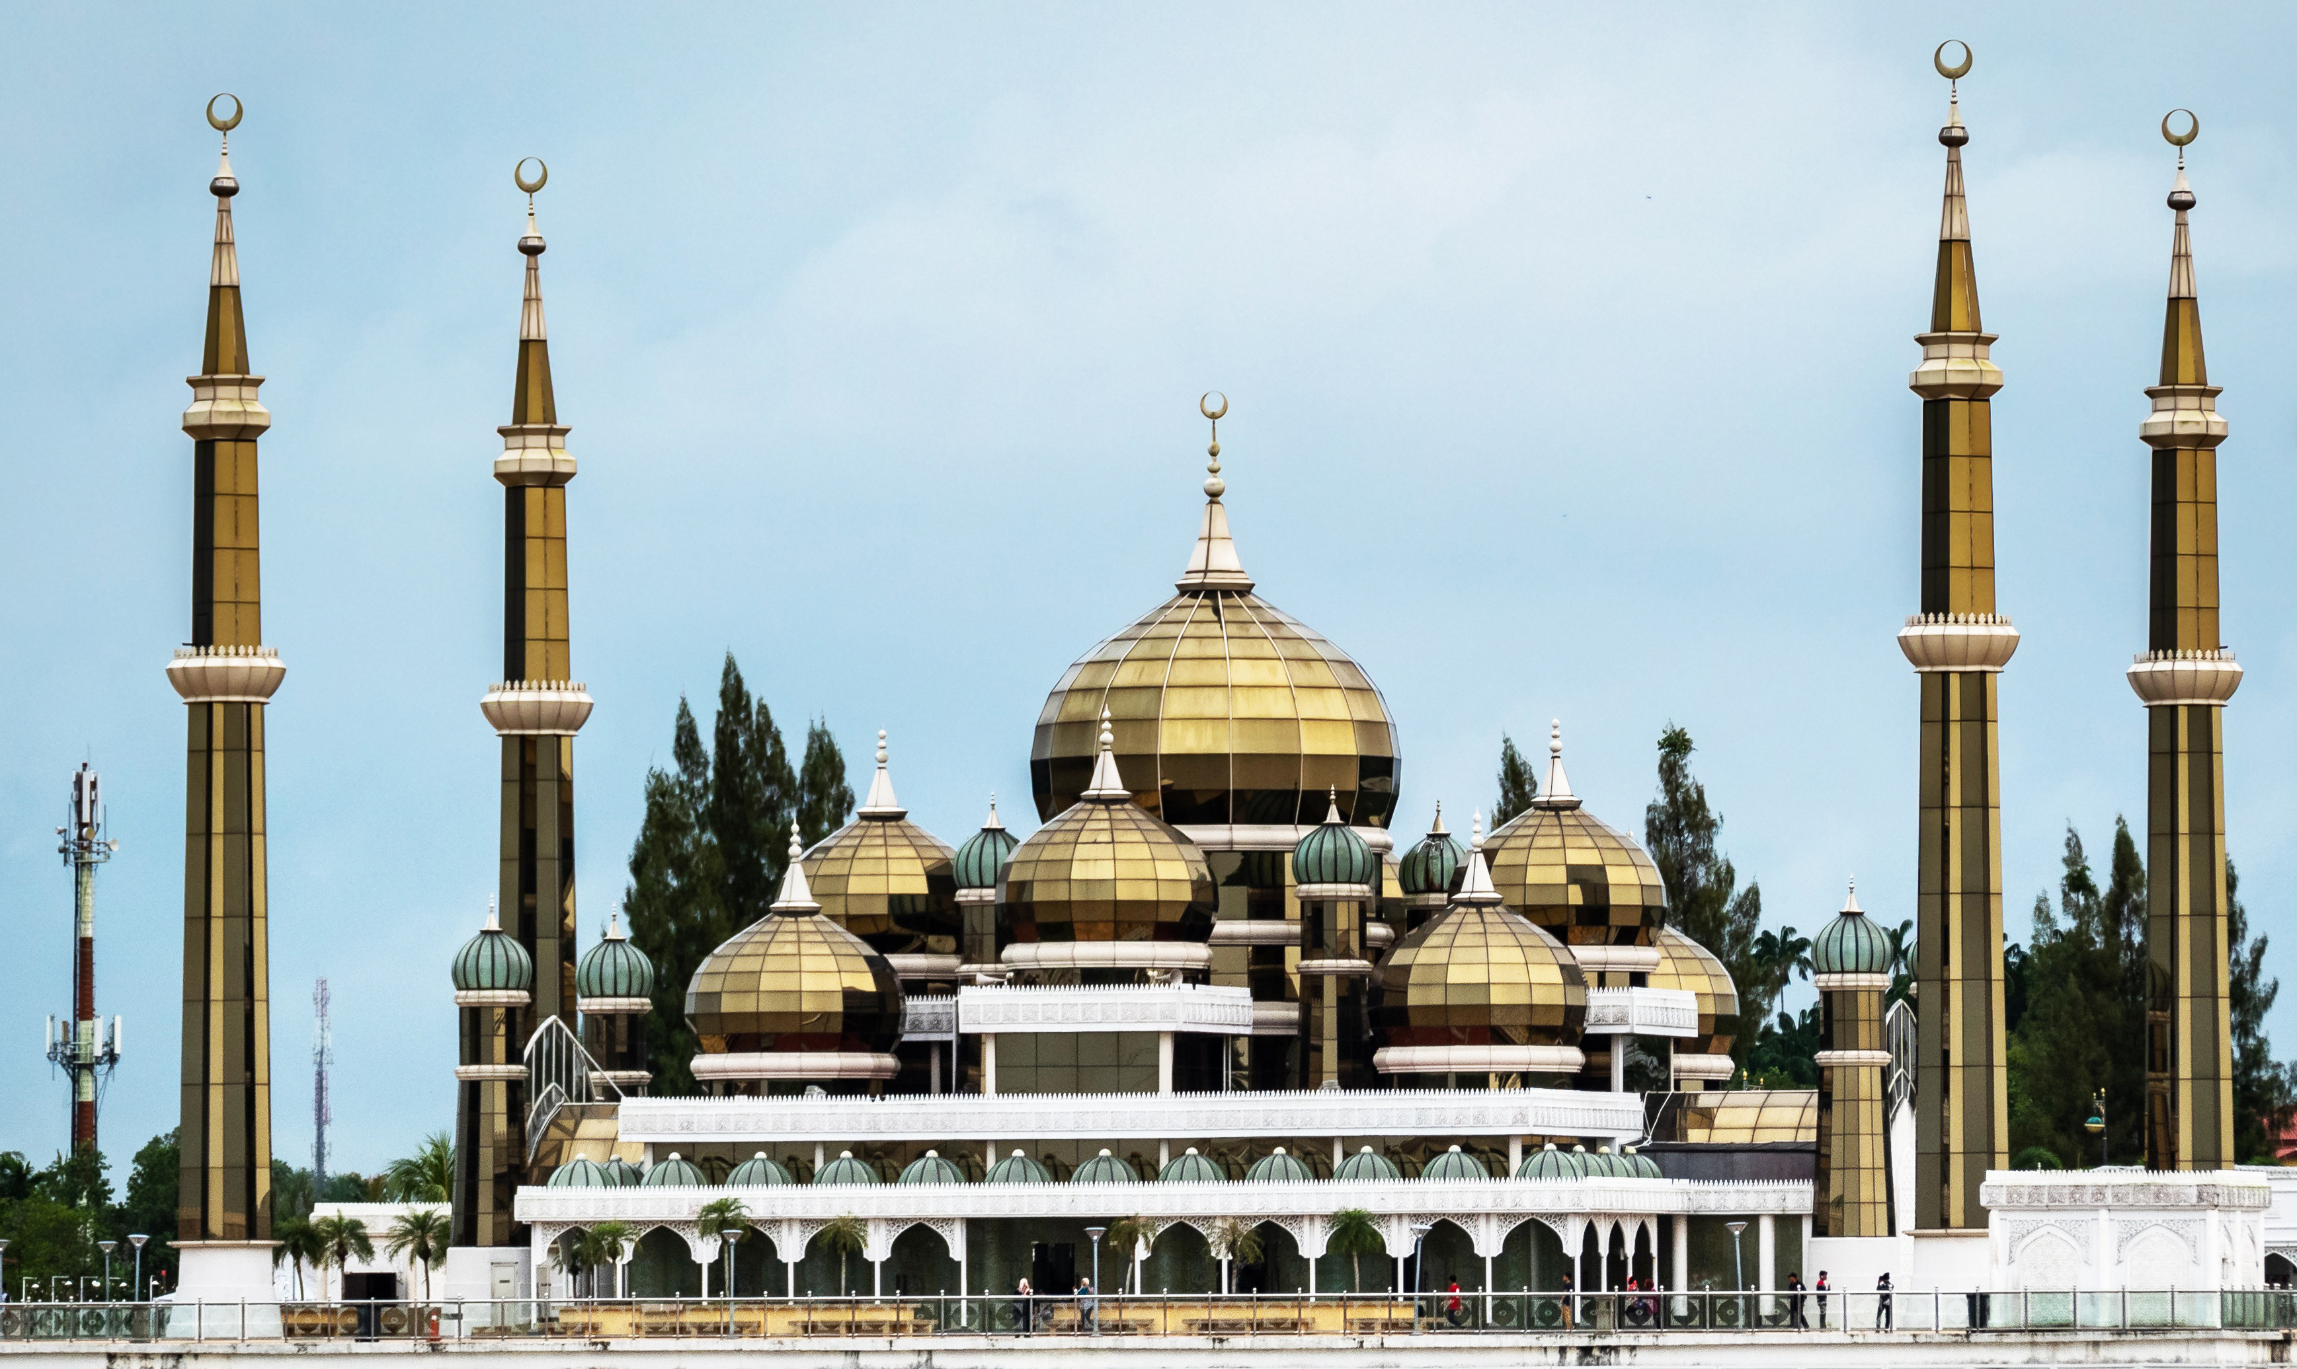
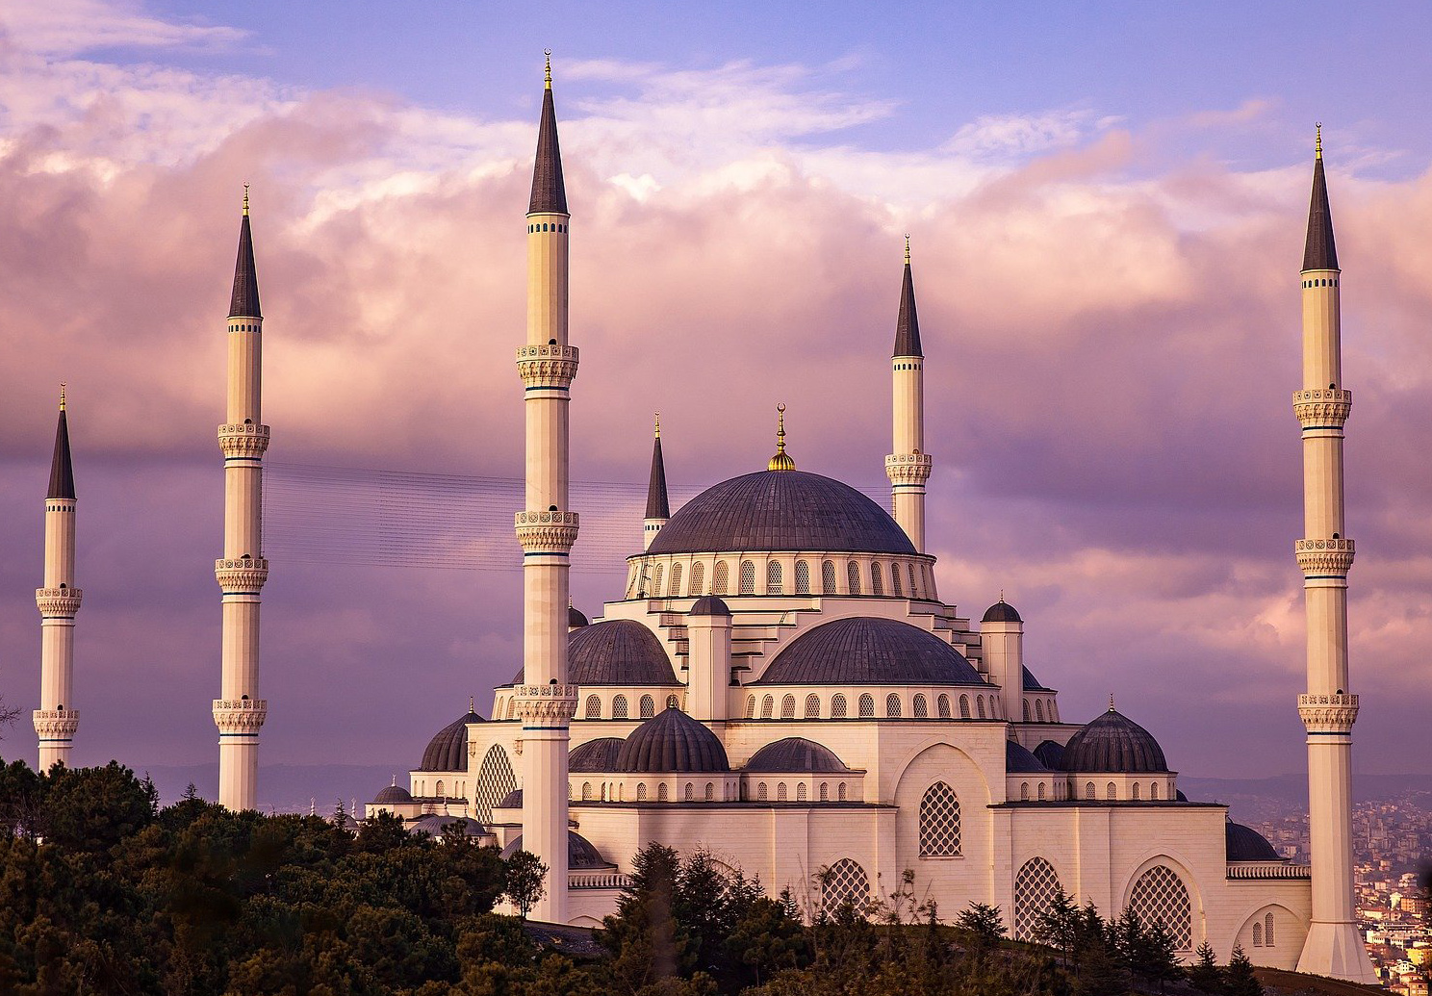
World
Religions
Sacred
Spaces
What Is Religion
Islam
In Islam, sacred spaces are called mosques. Mosques usually have at least one dome and at least one small tower, called a minaret. The tower is used to broadcast the call to prayer five times each day.
What Is Religion
Can you count the domes and minarets on each mosque?

Slide 8
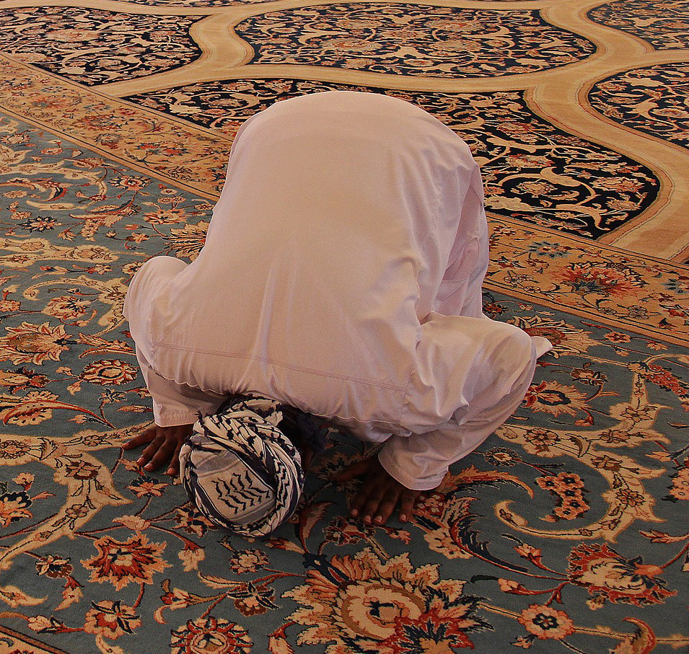
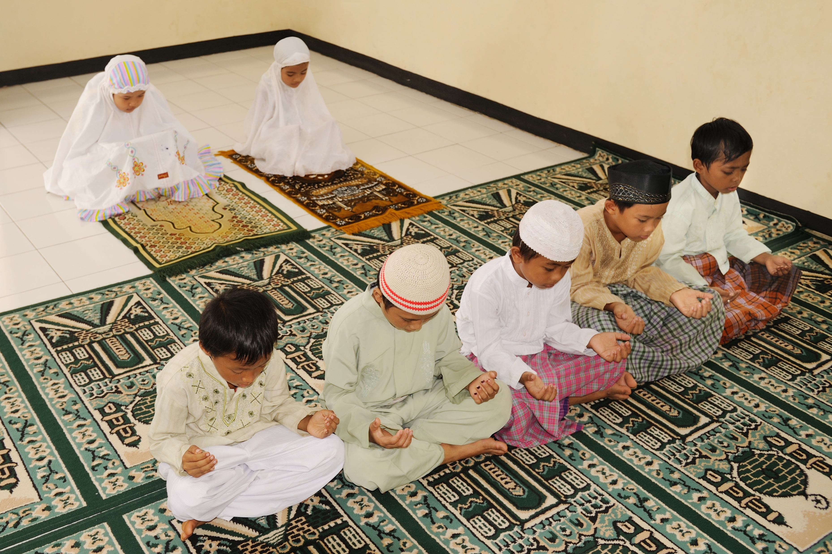
World
Religions
Sacred
Spaces
What Is Religion
Islamic Mosques
On the inside, mosques are mostly empty space. The floor is covered with a beautiful carpet, so everyone has room to pray. It is disrespectful to show images of the important people in this religion, so the decorations are usually colorful flowers or designs made with different shapes.
What Is Religion
These images show two Islamic prayer postures. Also, people often cover their heads when praying.
What Is Religion
Why do you think people might cover their heads in mosques?

Slide 9
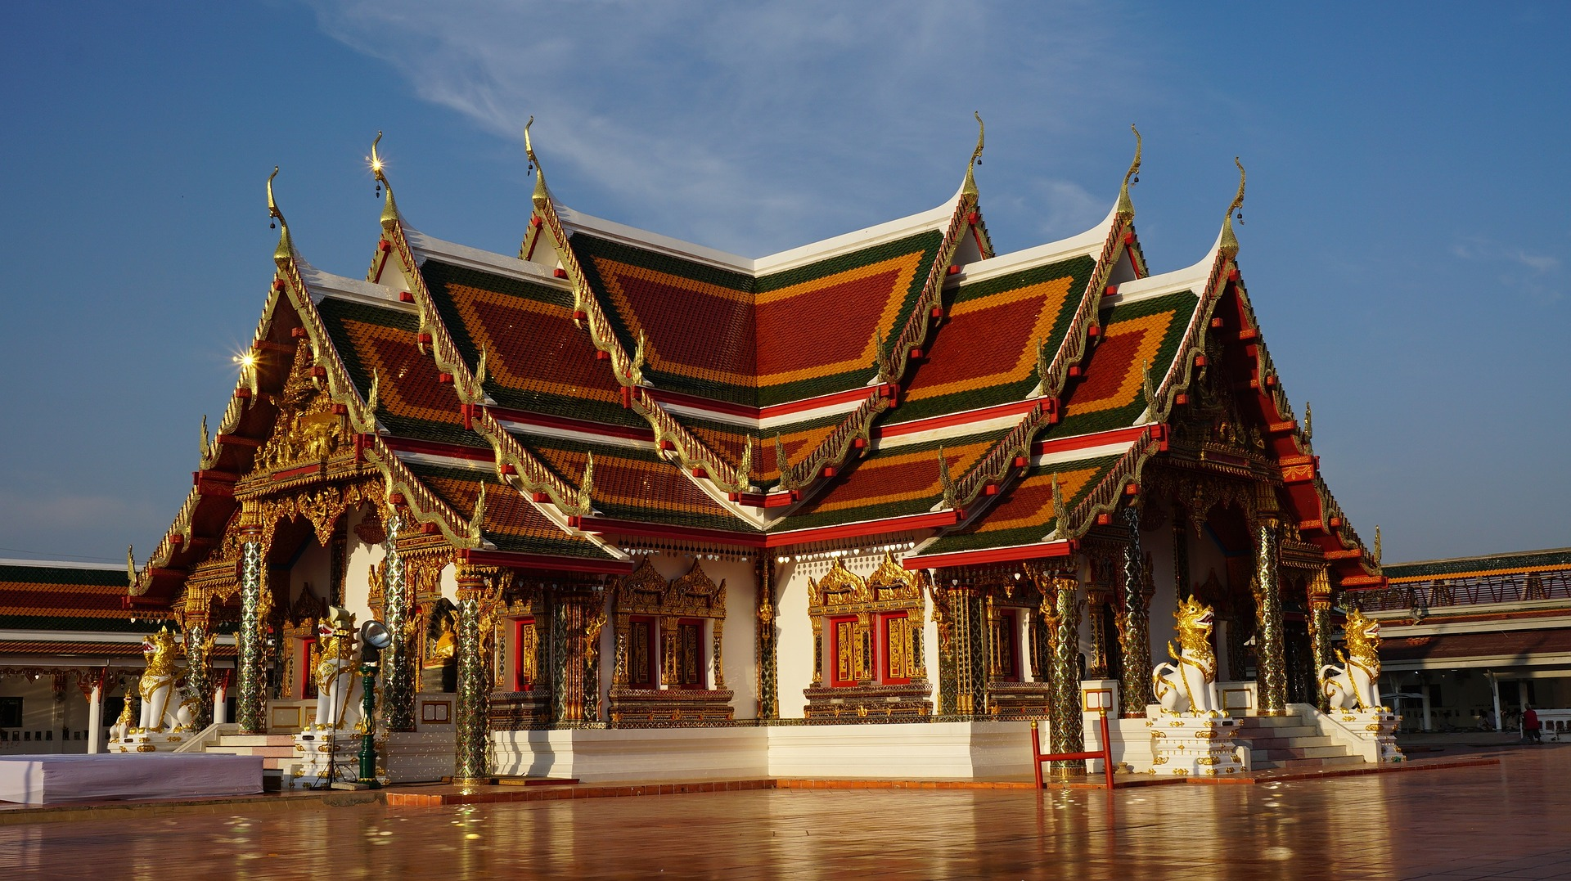
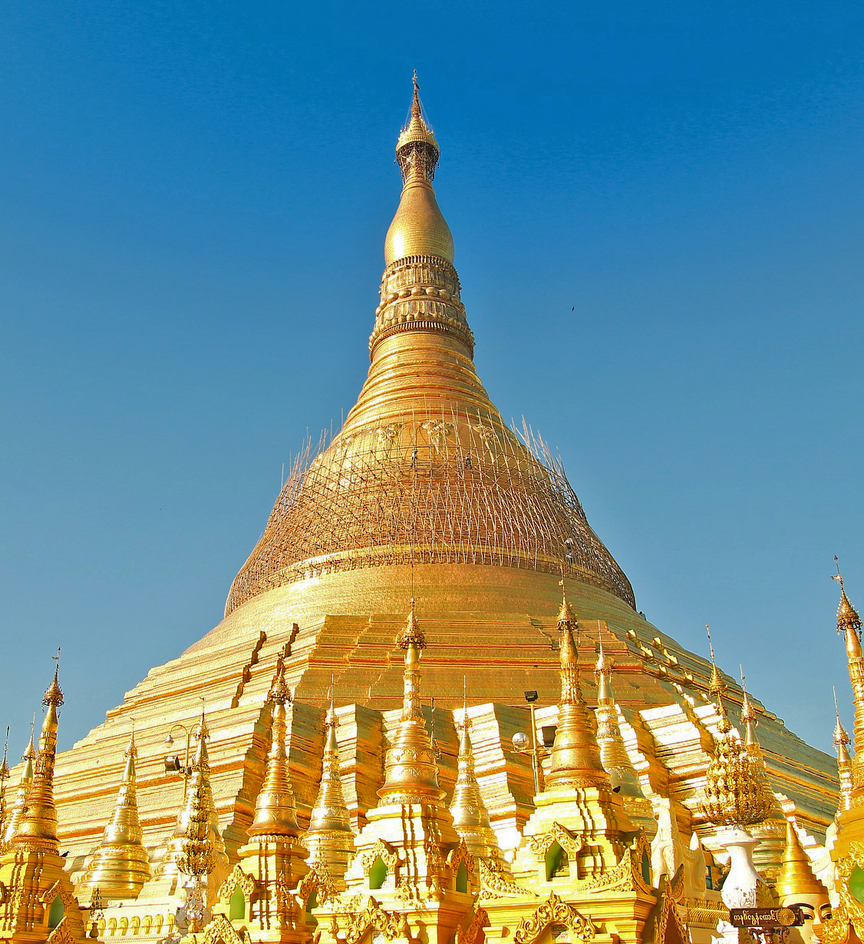
World
Religions
Sacred
Spaces
What Is Religion
Buddhism
The Buddhist religion is based on the teachings of a man, known as the Buddha, which means “Awakened One.” Buddhist sacred spaces are usually called temples.
What Is Religion
They also come in all shapes, sizes, and colors. But, many have a dome-like tower, called a stupah {STOO-puh}.

Slide 10
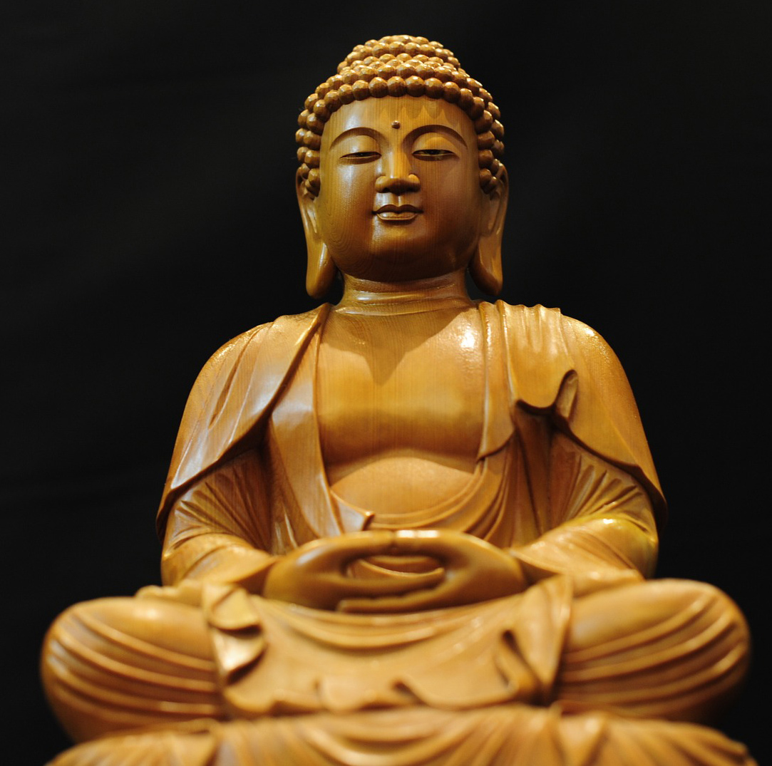
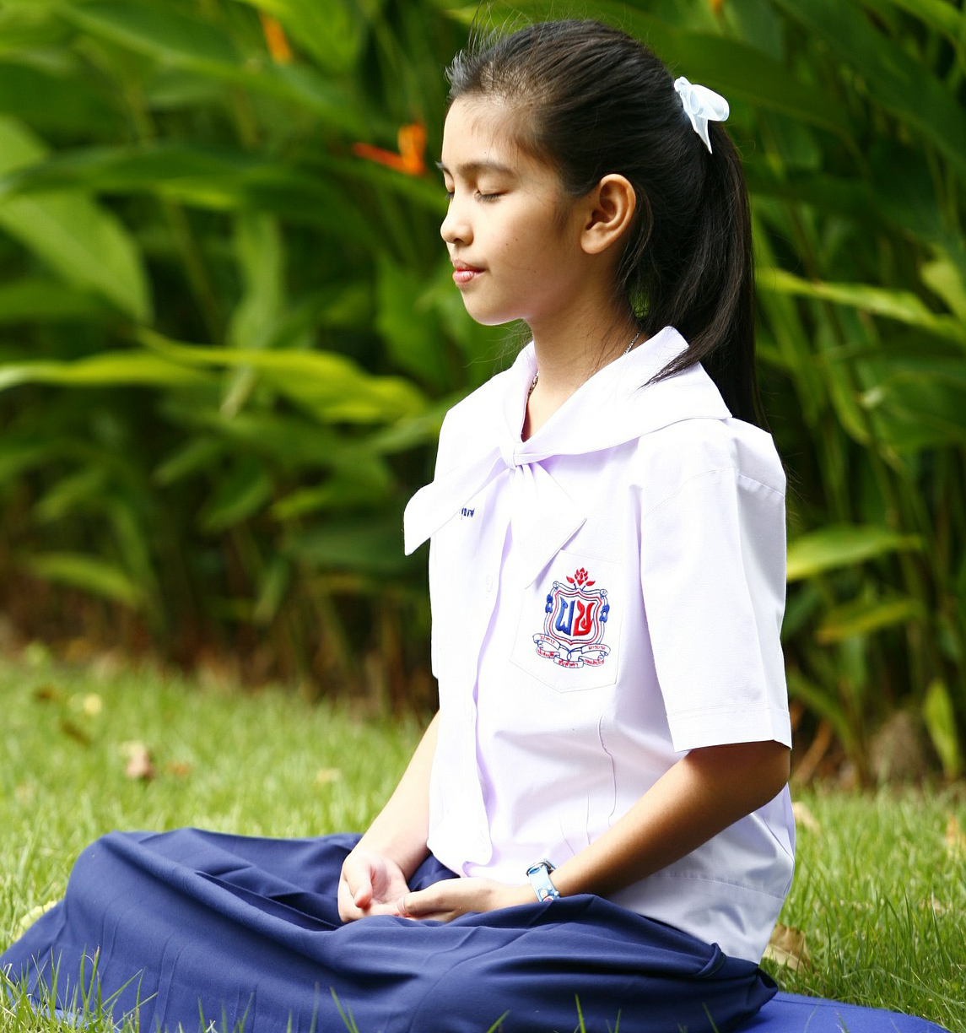
World
Religions
Sacred
Spaces
What Is Religion
Buddhist Temples
Inside a Buddhist temple, you will usually see an altar. It holds a statue of the Buddha, as well as candles and incense. You might also see offerings of food, flowers, or money.
What Is Religion
Many Buddhists also meditate, either at home or in the temple.
What Is Religion
Before entering a temple, Buddhist remove their shoes as a sign of respect.
What Is Religion
Do you think you would you like to remove your shoes in a sacred space?

Slide 11
World
Religions
Sacred
Spaces
What Is Religion
Sacred Spaces
The world is full of sacred spaces. They are sacred because they are important to the people who use them. And even though they are all different, it is important to treat them all with respect.
Now that you know more about sacred spaces, can you think of any sacred spaces you have visited?
Many sacred spaces can also be found in nature. Mountains, waterfalls, trees, and caves are good examples of natural sacred spaces that are special for many people.
Is there a place in nature that is special to you?
Which of these sacred spaces was your favorite? Why?

